Slide 1
Designing and Tuning for All-Flash Ceph RBD Storage
Ceph Days NYC 2024 April 26, 2024
Tyler Stachecki
Cloud Infrastructure

Slide 2
Designing for Scale

Slide 3
Designing for Scale
Our experience with OpenStack and Ceph dates all the way back to 2013 (Essex and Giant, respectively)
Design goals: Large clusters and dense, power-efficient compute and storage
~22 OSD/servers, CPU overcommit on hypervisors
First foray into Ceph and OpenStack taught us a lot of valuable lessons… most importantly, that L2 networks do not scale to many thousands of of VMs and are hard to debug; lots of weird interoperability issues between different vendors
In 2018, we began re-architecting our cloud and network…

Slide 4
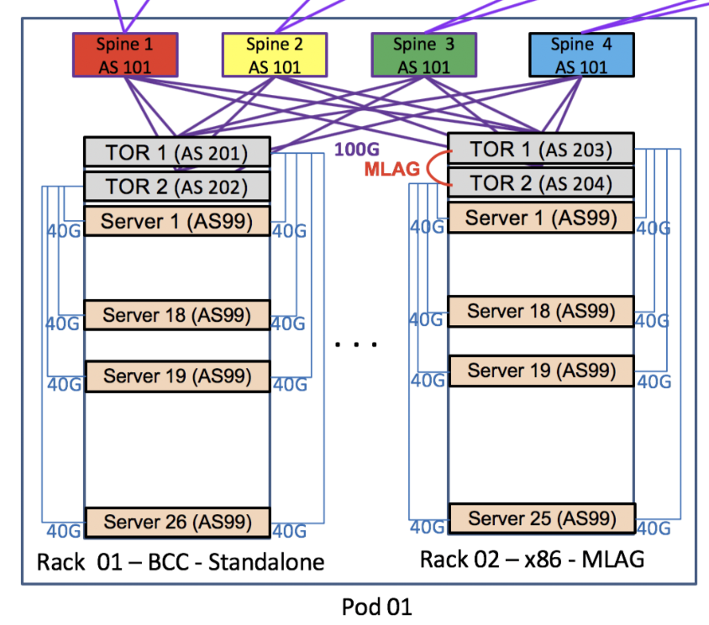
Designing for Scale: Pure L3 fabrics
Pure, BGP-based IP fabric with Layer 3 routing all the way down to the host for fast re-convergence on failure, stretched routing domains, no subnet constraints for tenants
Redundancy and maximal use of links achieved through BGP and ECMP
Multiple, disparate planes, each capable of >>1 Tbps of traffic

Slide 5
Designing for Scale: Pure L3 fabrics
Formatted and rebuilt all ~20K of our production OSDs when upgrading to Quincy: the network made it possible
L3 fabric unifies disparate networks (control, data, storage planes, …) usually prominent in VM+RBD deployments, thus allowing for either fewer links or more available bandwidth
Ancillary benefits incl. making rack/host movement in the data center more trivial

Slide 6
A Story on Swapping

Slide 7
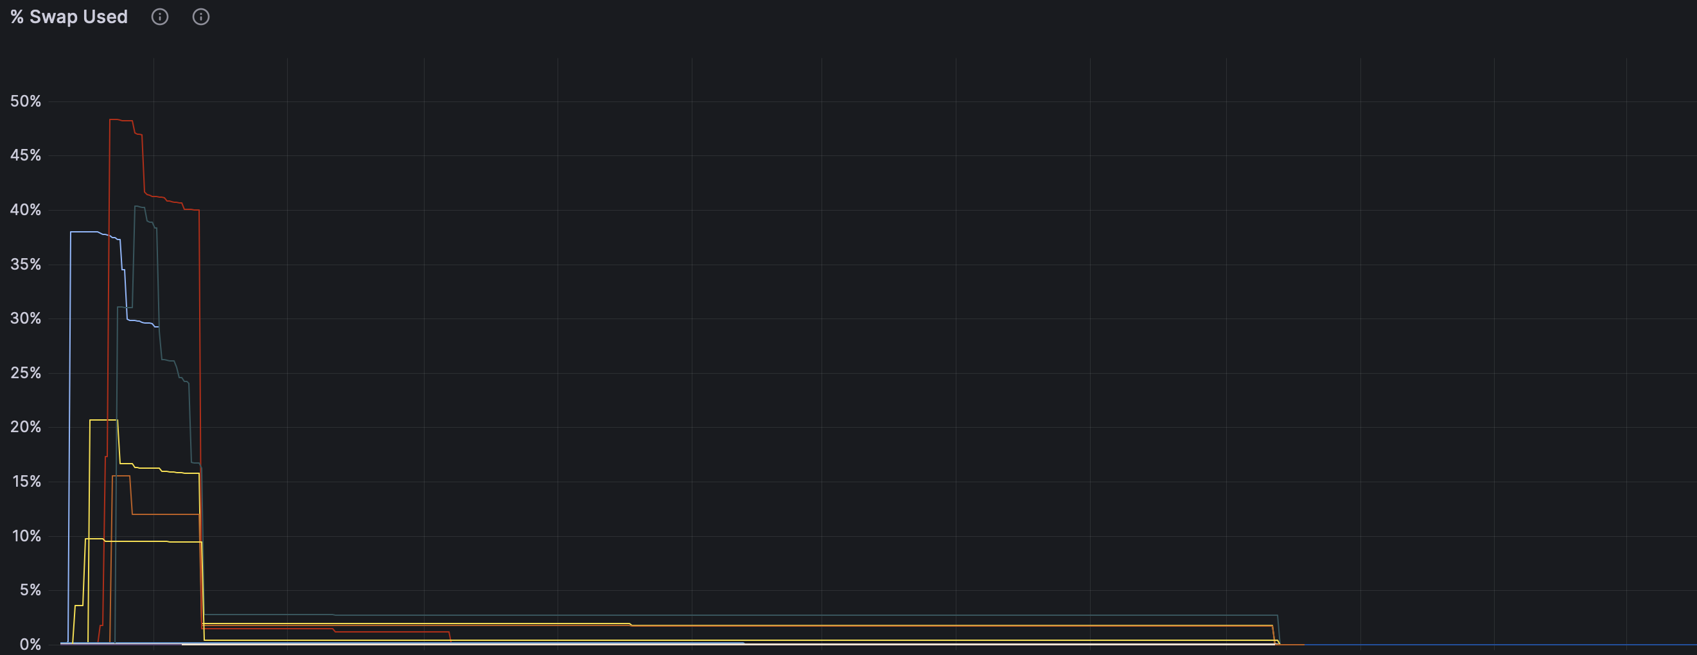
A Story on Swapping
In 2022-2023, we underwent an initiative to renovate our Ceph clusters running RBD workloads...

Slide 8
A Story on Swapping
In 2022-2023, we underwent an initiative to renovate our Ceph clusters running RBD workloads...
Drop memory target: 9GB → 7GB

Slide 9
A Story on Swapping
In 2022-2023, we underwent an initiative to renovate our Ceph clusters running RBD workloads...
Drop memory target: 9GB → 7GB
???

Slide 10
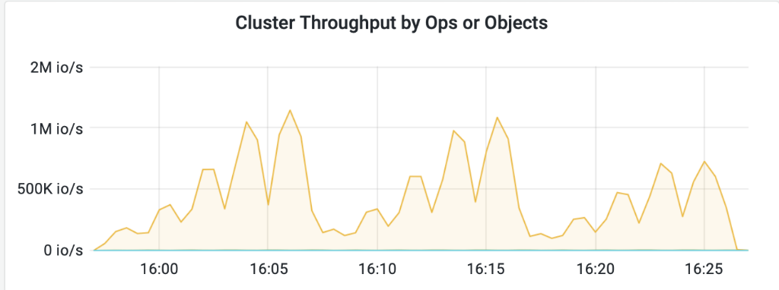
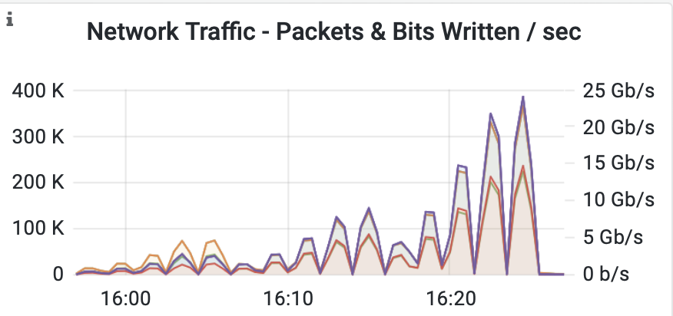
A Story on Swapping
Started setting up benchmarks on our lab cluster
Metrics shown are not indicative of performance figures of our production systems
120 RBD clients running fio, 330 OSDs, 2x25Gbps networking
Different r/w mixes (0/100, 100/0, 70/30), block sizes, queue depths, IOPS limits…
4K Block
16K Block
64K Block

Slide 11
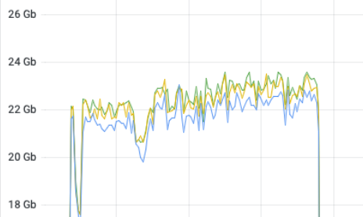
A Story on Swapping
Early on, we identified a big problem with our benchmarking setup:
4K, 1QD Read: ~186K IOPS (5% run-to-run variance)
64K, 16QD Write: ~150K IOPS (10% run-to-run-variance)

Slide 12
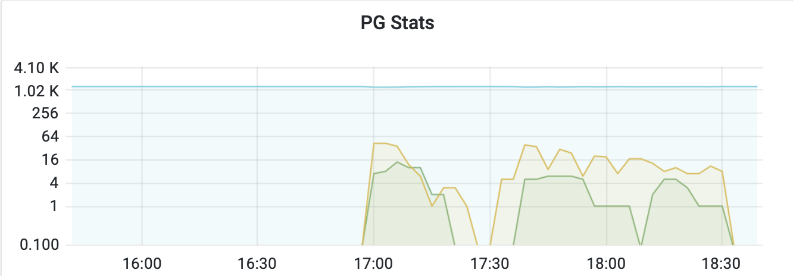
A Story on Swapping
Do not forget to turn off scrubbing when benchmarking…
But, do not set it ‘off’ indefinitely either

Slide 13
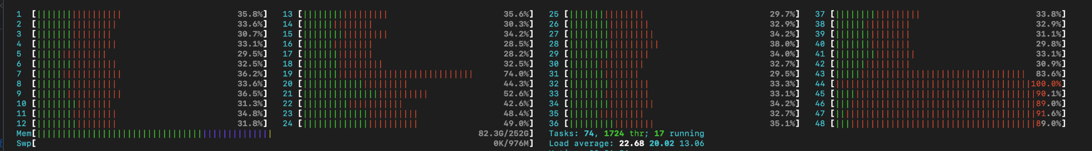
A Story on Swapping
Why are some cores so overloaded compared to others?

Slide 14
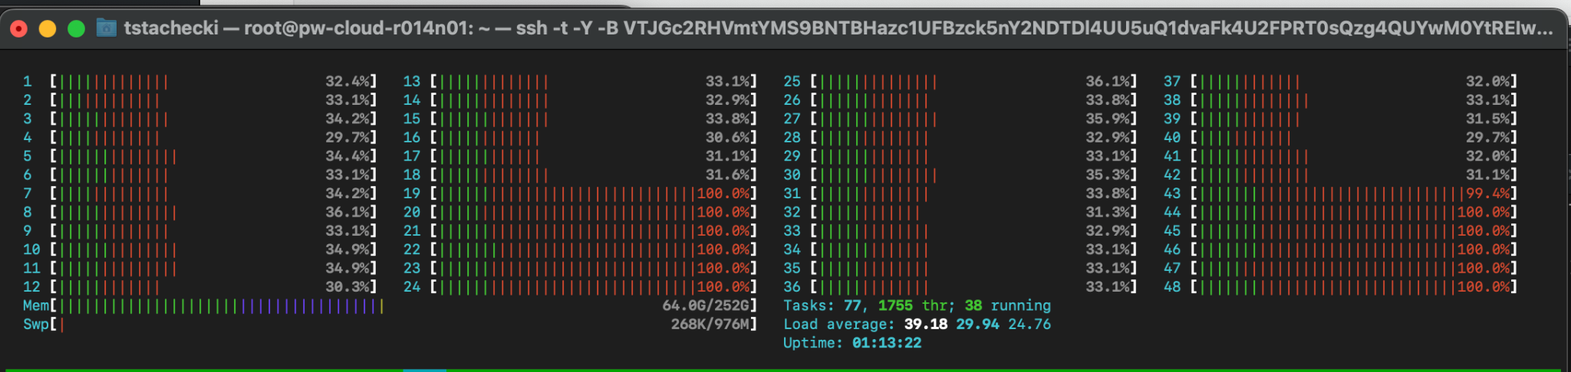
A Story on Swapping
Why are some cores so overloaded compared to others?
Change NUMA setting in NIC driver from local cores (default) to local threads

Slide 15
A Story on Swapping
numastat:
node0 node1 node2 node3
numa_hit 881983537 888572582 745775975 32314773050
numa_miss 0 12848350 6769274 415898270
numa_foreign 117258094 172283056 145974729 0
interleave_hit 25851 26008 25827 25999
local_node 881974471 888538666 745745346 32314760894
other_node 9066 12882266 6799903 415910359

Slide 16
A Story on Swapping
numastat:
node0 node1 node2 node3
numa_hit 881983537 888572582 745775975 32314773050
numa_miss 0 12848350 6769274 415898270
numa_foreign 117258094 172283056 145974729 0
interleave_hit 25851 26008 25827 25999
local_node 881974471 888538666 745745346 32314760894
other_node 9066 12882266 6799903 415910359
Eureka: we were swapping in production because some zones were starving for memory and reacting accordingly!
Disabling swap is the wrong thing to do: kernel will still page out (and likely more aggressively with swap disabled), leading to lots of page churning and memory accesses spilling into other NUMA nodes

Slide 17
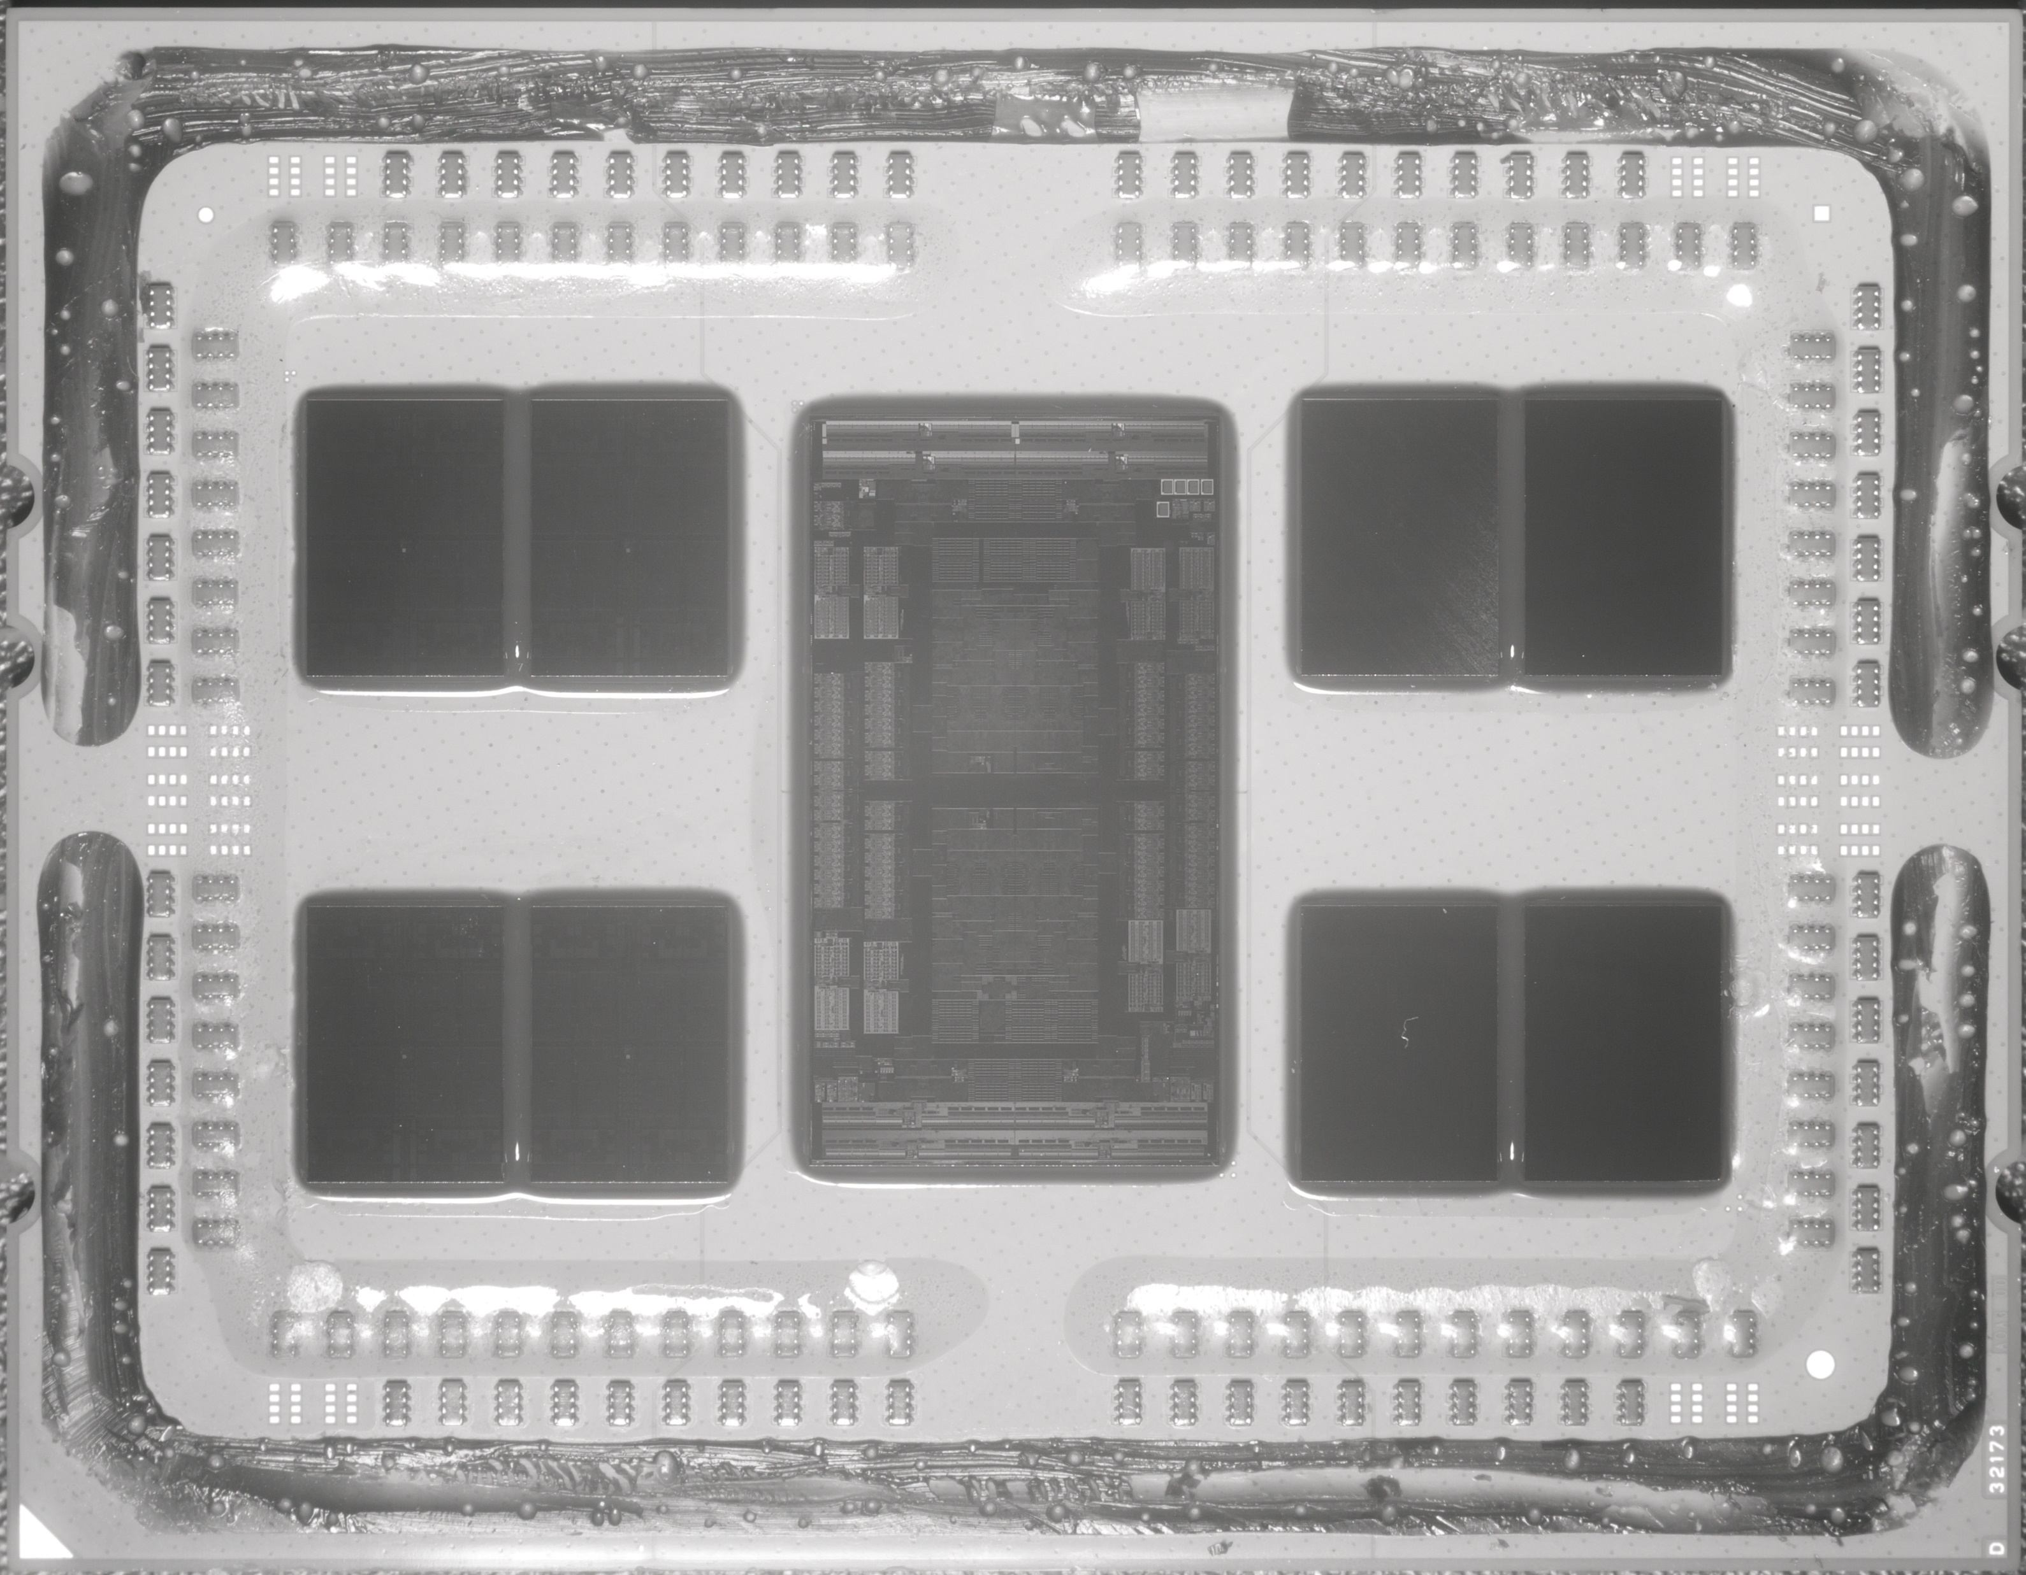
A Story on Swapping
Intra-chiplet latency: 20-30ns
(“AMD Epyc 7702 ES” by Fritzchens Fritz licensed under CC0 1.0 DEED)

Slide 18
A Story on Swapping
Intra-chiplet latency: 20-30ns
Adjacent-chiplet latency: 80-90ns
(“AMD Epyc 7702 ES” by Fritzchens Fritz licensed under CC0 1.0 DEED)

Slide 19
A Story on Swapping
Intra-chiplet latency: 20-30ns
Adjacent-chiplet latency: 80-90ns
Chiplet across I/O die: 110-120ns
(“AMD Epyc 7702 ES” by Fritzchens Fritz licensed under CC0 1.0 DEED)

Slide 20
A Story on Swapping
Intra-chiplet latency: 20-30ns
Adjacent-chiplet latency: 80-90ns
Chiplet across I/O die: 110-120ns
Chiplet across package: ~200ns
(“AMD Epyc 7702 ES” by Fritzchens Fritz licensed under CC0 1.0 DEED)

Slide 21
A Story on Swapping
Intra-chiplet latency: 20-30ns
Adjacent-chiplet latency: 80-90ns
Chiplet across I/O die: 110-120ns
Chiplet across package: ~200ns
Up to ~5x latency in a 1P system
Up to ~10x latency in a 2P system
(“AMD Epyc 7702 ES” by Fritzchens Fritz licensed under CC0 1.0 DEED)

Slide 22
A Story on Swapping
Intra-chiplet latency: 20-30ns
Adjacent-chiplet latency: 80-90ns
Chiplet across I/O die: 110-120ns
Chiplet across package: ~200ns
Up to ~5x latency in a 1P system
Up to ~10x latency in a 2P system
Most HW vendors “hide” the chiplet-level topology (8 NUMA zones) from the OS by default and only show 4 NUMA zones!
(“AMD Epyc 7702 ES” by Fritzchens Fritz licensed under CC0 1.0 DEED)

Slide 23
A Story on Swapping
Kernel does not know how to optimally configure multi-process workloads like Ceph
Our Ceph block servers use a systemd service shim to configure Ceph with a-priori knowledge:
$ cat /etc/systemd/system/ceph-osd@.service.d/override.conf
[Service]
ExecStart=
ExecStart=/usr/bin/bbcephtool exec_osd -f --cluster ${CLUSTER} --id %i --setuser ceph --setgroup ceph
bbcephtool probes the system for all OSDs and performs global scheduling
It instructs the kernel to assign this OSD to a particular chiplet in order to leverage the locality and restricted coherence domain of modern chiplet-based microarchitectures

Slide 24
A Story on Swapping
Before:
node0 node1 node2 node3
numa_hit 881983537 888572582 745775975 32314773050
numa_miss 0 12848350 6769274 415898270
numa_foreign 117258094 172283056 145974729 0
interleave_hit 25851 26008 25827 25999
local_node 881974471 888538666 745745346 32314760894
other_node 9066 12882266 6799903 415910359
After:
node0 node1 node2 node3
numa_hit 45697885068 818961266817 57096939504 60297664855
numa_miss 723914 4654022 27846460 407840
numa_foreign 4629624 27868400 387372 746840
interleave_hit 17523 17106 17532 17094
local_node 45697875953 818938581714 57096806186 60297320431
other_node 797371 4867960 27951674 872478

Slide 25
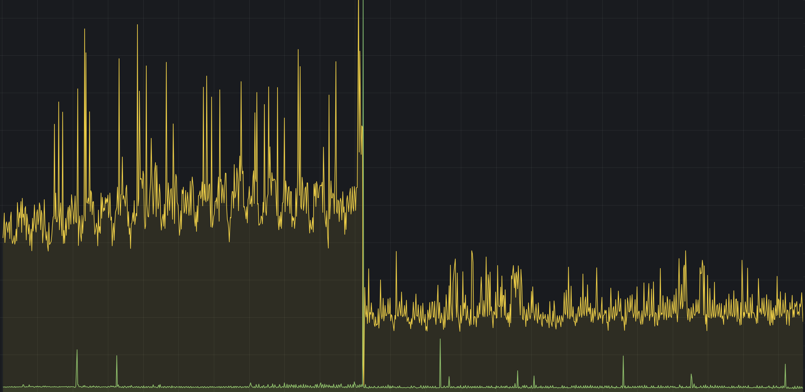
A Story on Swapping
Number of context switches on a production host as we deploy the changes…

Slide 26
A Story on Swapping
Remember that variance we saw in our lab cluster before?
 | Before Tuning | After Tuning
4K, 1QD Read IOPS | 186K (5% variance) | 215K (<1% variance)
64K, 16QD Write IOPS | 150K (10% variance) | 181K (~2.5% variance)

Slide 27
A Story on Swapping
NUMA tuning’s purpose is not only memory latency:
Drop memory target: 9GB → 7GB
Applied NUMA tuning...
and increased the memory target again

Slide 28
A Story on Swapping
Have a solid understanding of what you are changing and why – Do not make reactionary decisions
NUMA tuning is quintessential for consistent performance in deployments targeting a dense number of OSDs/host
Look at your BIOS settings to see if you are forgoing “sub-” NUMA optimizations; you probably are, unless you looked already

Slide 29
Hey, we saw this, too!
“That's when I noticed that we were not, in fact, building RocksDB with the correct compile flags. It's not clear how long that's been going on…” – ceph.io blog post, Jan 19, 2024

Slide 30
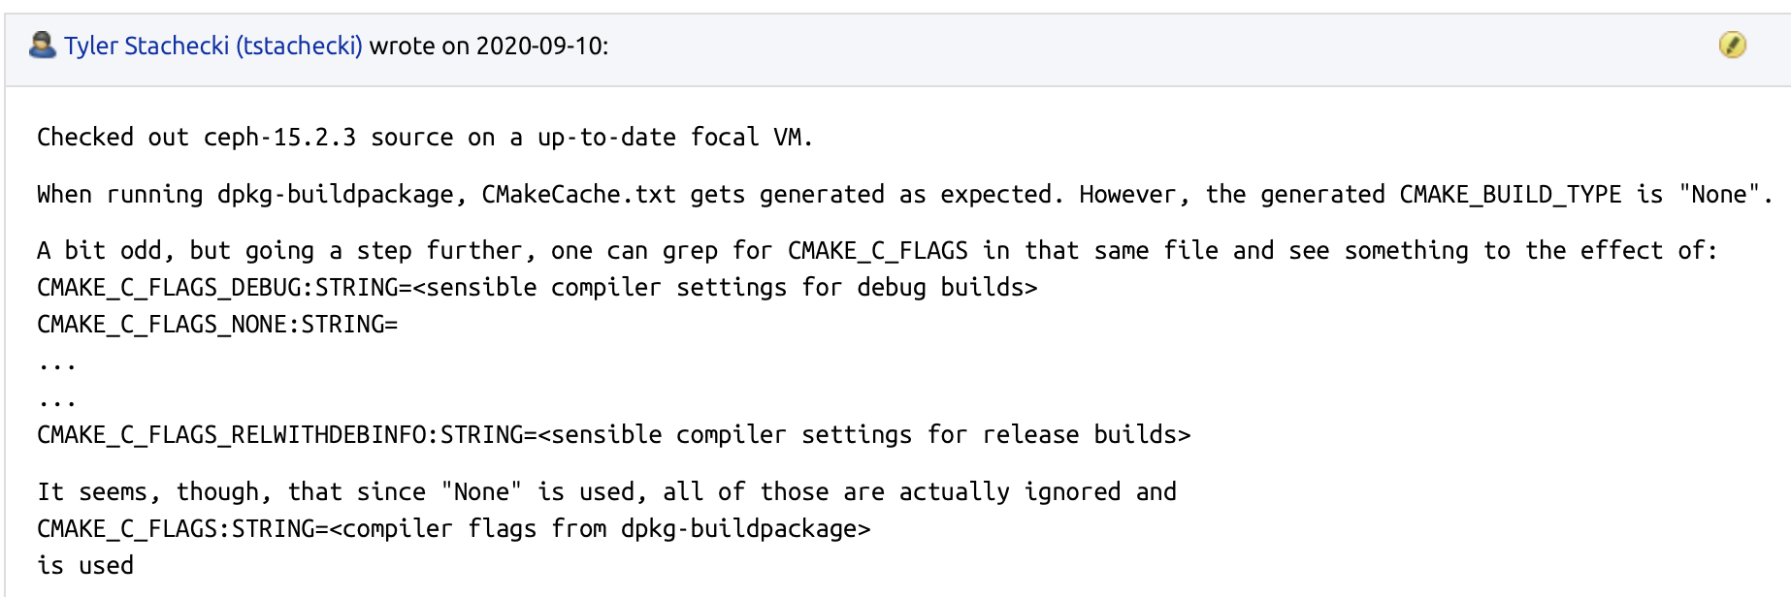
Hey, we saw this, too!
“That's when I noticed that we were not, in fact, building RocksDB with the correct compile flags. It's not clear how long that's been going on…” – ceph.io blog post, Jan 19, 2024

Slide 31
Hey, we saw this, too!
“That's when I noticed that we were not, in fact, building RocksDB with the correct compile flags. It's not clear how long that's been going on…” – ceph.io blog post, Jan 19, 2024
(oops… Bloomberg had known about this, and we really should have made the upstream contributions to fix it)
Hopefully, today, we will make up for that by sharing some of the findings we have discovered since then… and share more going forward

Slide 32
Here Today, Gone Tomorrow

Slide 33
Here Today, Gone Tomorrow
Your cluster is only as fast as your slowest OSD
In an all-flash cluster, if you have a sluggish OSD, this becomes especially noticeable!
Sometimes, the slowest OSD right now is a “quick” OSD just shortly later (examples to come)
Telemetry can put you in front of what’s slow right now
Fixing what’s infrequently very slow improves your worst-case scenarios

Slide 34
Here Today, Gone Tomorrow
Your cluster is only as fast as your slowest OSD
In an all-flash cluster, if you have a sluggish OSD, this becomes especially noticeable!
Sometimes, the slowest OSD right now is a “quick” OSD just shortly later (examples to come)
Telemetry can put you in front of what’s slow right now
Fixing what’s infrequently very slow improves your worst-case scenarios
Your “worst case” is what your users really care about

Slide 35
Here Today, Gone Tomorrow
Before we “pick” on Ceph, let’s first walk through a mistake we made ourselves
There’s a popular RocksDB setting online that looks similar to this:
default[‘bcpc’][‘ceph’][‘bluestore_rocksdb_options’] = [
‘compression=kNoCompression’,
‘max_write_buffer_number=4’,
‘min_write_buffer_number_to_merge=1’,
‘recycle_log_file_num=4’,
‘write_buffer_size=268435456’,
’writeable_file_max_buffer_size=0’,
’compaction_readahead_size=2097152’,
‘max_background_compactions=4’,
]
Similar settings appear in multiple vendor whitepapers, online searches, … and actually work quite well for Ceph versions from the era for which the setting was published

Slide 36
Here Today, Gone Tomorrow
Then came RocksDB column families (a good thing!)
… but they necessitate an additional option to keep WAL sizes at sane levels (#35277)

Slide 37
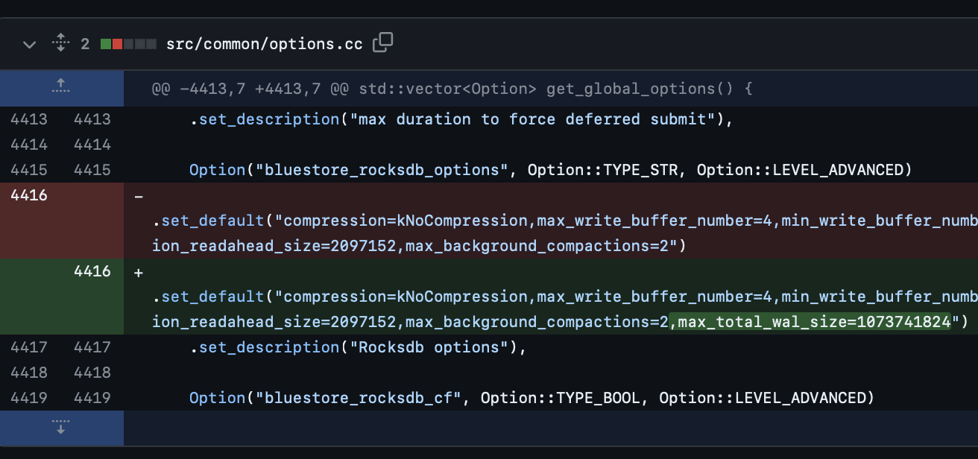
Here Today, Gone Tomorrow

Slide 38
Here Today, Gone Tomorrow
Then came RocksDB column families (a good thing!)
… but they necessitate an additional option to keep WAL sizes at sane levels (#35277)
without max_total_wal_size being appended to your RocksDB settings, you will experience insufferably bad latencies when OSDs need to compact WALs (that grow to ~100GB…)
The setting is not additive or a default, so without specifying it explicitly as part of your overridden RocksDB options, your cluster will suffer
In most cases, the effects of not including the setting will take >1d to manifest

Slide 39
Here Today, Gone Tomorrow
Extreme case of this: once in a blue moon on a specific platform, we see hardware failures that manifest as missed interrupts from the NVMe. The IOP is then polled and completes.
NVMe timeout in Linux defaults to… what? $ cat /sys/module/nvme_core/parameters/io_timeout
30
After 30 seconds, the kernel polls the NVMe to say hey… about that I/O access…
If this keeps happening, Ceph is self-healing and marks the OSD out, right?

Slide 40
Here Today, Gone Tomorrow
Extreme case of this: once in a blue moon on a specific platform, we see hardware failures that manifest as missed interrupts from the NVMe. The IOP is then polled and completes.
NVMe timeout in Linux defaults to… what? $ cat /sys/module/nvme_core/parameters/io_timeout 30
After 30 seconds, the kernel polls the NVMe to say hey… about that I/O access…
If this keeps happening, Ceph is self-healing and marks the OSD out, right?
… right?
$ sudo ceph daemon osd.X config get osd_op_thread_suicide_timeout | jq -r .osd_op_thread_suicide_timeout
150

Slide 41
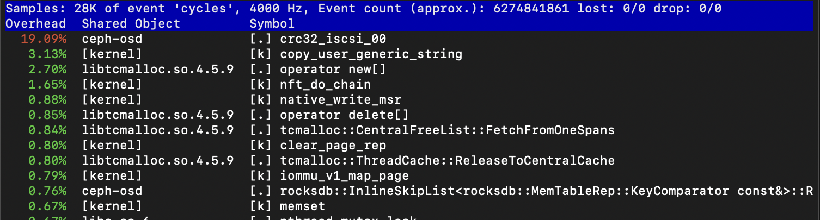
Here Today, Gone Tomorrow
Different case: Let us look at an outlier in a cluster of 4K+ OSDs & >10K+ RADOS clients
perf top –p 66111

Slide 42
Here Today, Gone Tomorrow
Different case: Let us look at an outlier in a cluster of 4K+ OSDs & >10K+ RADOS clients
perf top –p 66111

Slide 43
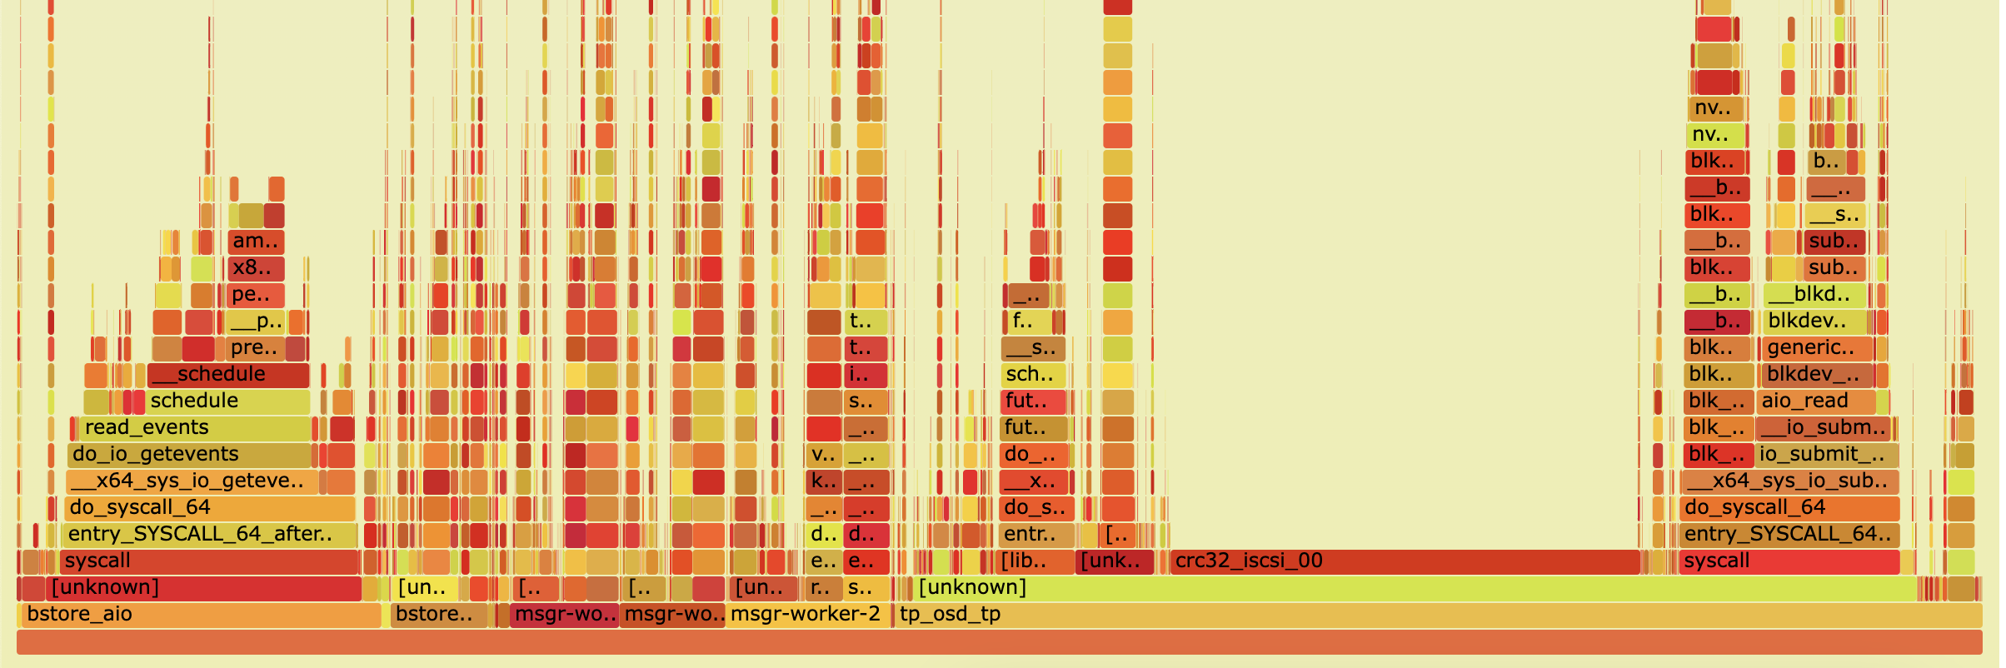
Here Today, Gone Tomorrow
perf record –gp 66111 -- sleep 30; perf script > stack.out
./stackcollapse-perf.pl < stack.out | ./flamegraph.pl > osd.svg
crc32_iscsi_00

Slide 44
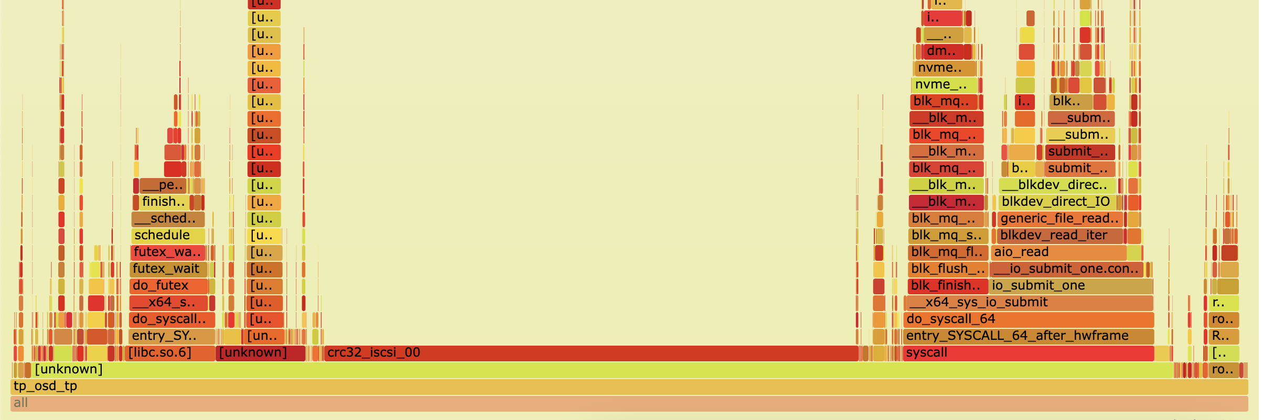
Here Today, Gone Tomorrow
OSD thread pool was spending 43% of it’s time calculating CRCs over a 30-second period!

Slide 45
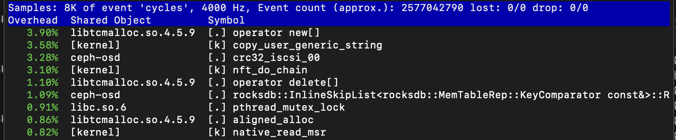
Here Today, Gone Tomorrow
Now the kicker: Let’s look at this same process just minutes later:
perf top –p 66111

Slide 46
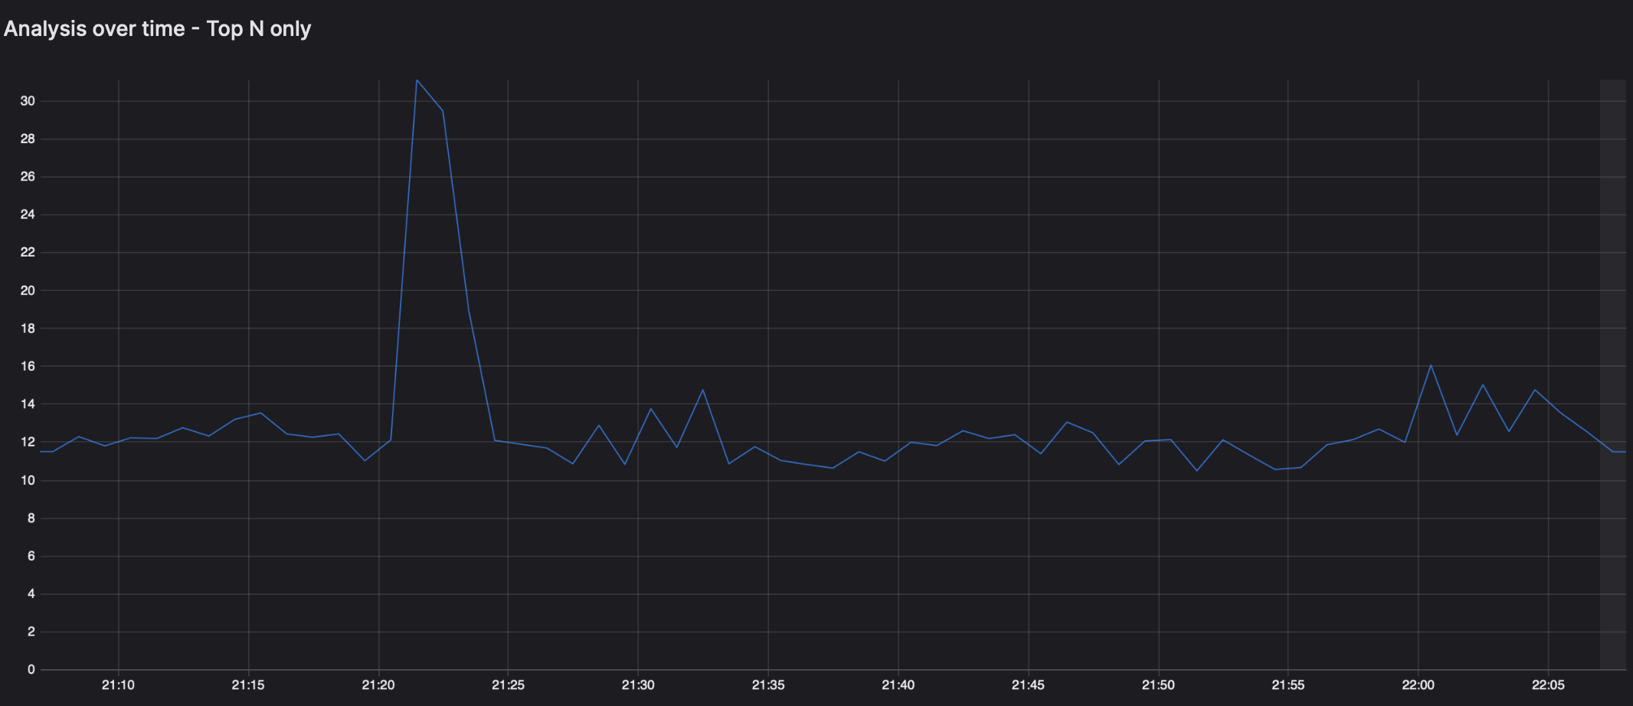
Here Today, Gone Tomorrow
crc32_iscsi_00

Slide 47
Here Today, Gone Tomorrow
ISA-L has multiple CRC32 implementations – ceph uses crc32_iscsi_00
crc32_iscsi_00: Uses CPU’s native crc32 instructions
crc32_iscsi_01: Uses pclmulqdq to vectorize folding of the message buffer

Slide 48
Here Today, Gone Tomorrow
ISA-L has multiple CRC32 implementations – ceph uses crc32_iscsi_00
crc32_iscsi_00: Uses CPU’s native crc32 instructions
crc32_iscsi_01: Uses pclmulqdq to vectorize folding of the message buffer
pclmulqdq version also benefits from a smaller look-up table and hence pollutes L1D$ less
CPU | crc32_iscsi_00 | crc32_iscsi_01
Vendor A, Server Gen 2 uArch | 10241 MB/s | 13500 MB/s (+31%)
Vendor A, Server Gen 3 uArch | 21645 MB/s | 21469 MB/s (wash)
Vendor B, Personal Laptop | 14691 MB/s | 21084 MB/s (+43%)
Vendor B, Low Power/Edge | 2887 MB/s | 3664 MB/s (+26%)

Slide 49
Here Today, Gone Tomorrow
Do not copy ceph.conf changes from online unless you understand why and what they do!
Adapt osd_op_thread_suicide_timeout to HDD/SSD use cases, set SSD case to something less than 30s
Is it time to change the default CRC32 implementation?
It is important to have time-series- based telemetry to identify issues that come and go
Notes:
d

Slide 50
Thank You!
We’re hiring!
https://www.bloomberg.com/careers

